Slide 1
The Writing Center
SMC Campus Center
Room 307 and Online
410-706-7725
umaryland.edu/writing
Dr. Isabell May, Director (she/her/hers)
James Wright, Associate Director (he/him/his)
Hannah Mueller, Writing Specialist (she/her/hers)

Slide 2
HOURS
Fall 2023
Monday-Friday 10 a.m.- 8 p.m.
Saturday 11 a.m. - 4 p.m.
Hours may change. The online scheduler is
always up to date.
Writing consultations are by appointment.

Slide 3
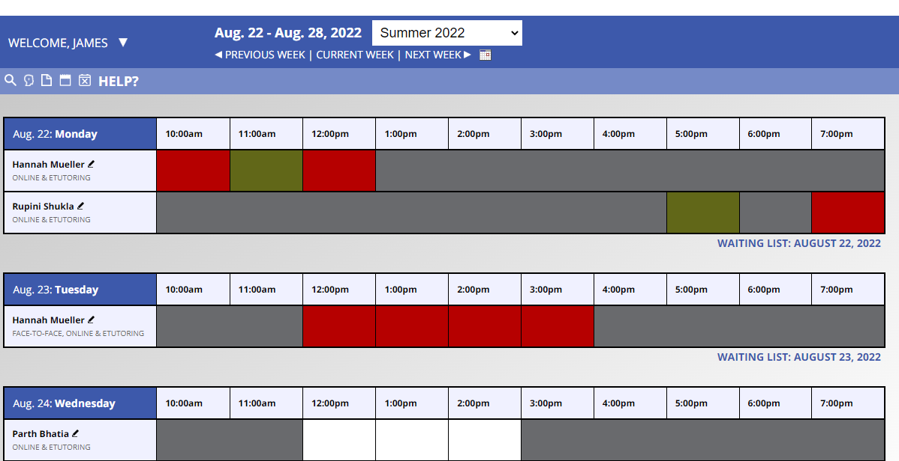
SERVICES
Summer and Fall 2023
Online synchronous consultation
E-tutoring asynchronous consultation
One-to-one, in-person consultation in the Center

Slide 4
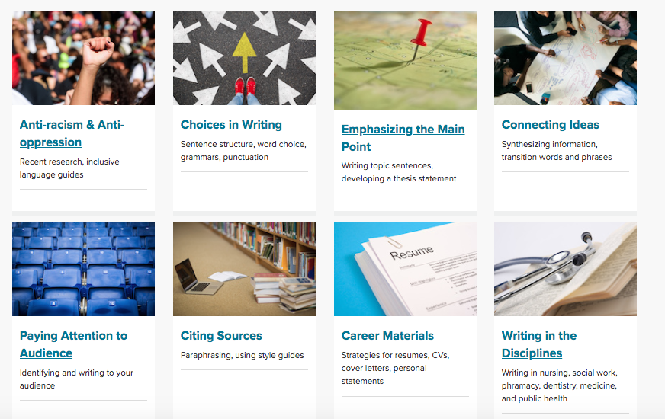
Resources
Go to www.umaryland.edu/writing/writing-resources

Slide 5
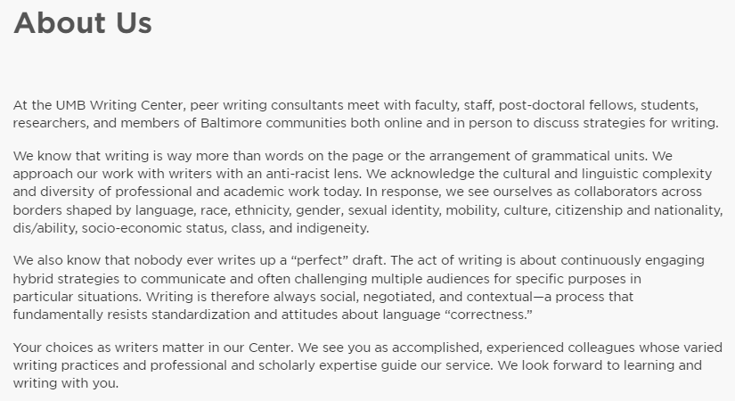
Make an Appointment at www.umaryland.edu/writing

Slide 6
Will you edit and proofread?
Consultants …
are not grammarians or trained editors
are peers trained as para-educators
work with you to develop self-editing and proofreading strategies that include online and print handbooks and other guides.

Slide 7
Consultant Preparation
Annual 3-day training seminar
Shadowing experience
Monthly small-cohort discussion groups
Baltimore Writing Center Project (BWCP)

Slide 8
Events
UMB Writing Center
Open House
Friday, September 8
12-2pm
In-person and Online

Slide 9
Programming Highlights
Writing Accountability Groups (WAGs)
Multilingual Writing Fellows Program
Global Perspectives Conversation Program partnership with OIS
Linguistic justice and antiracism framework for writing consultation
Student professional development workshops
The Faculty Fellows for Equitable Assessment and Teaching (FFEAT) Program
Conference attendance and presentations
Baltimore Metro Writing Centers Association (BMetWCA)
Baltimore Writing Center Project (BWCP)

Slide 10
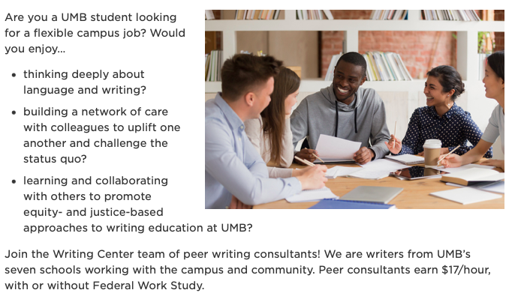
Join Our Staff!
To start the application process: www.umaryland.edu/writing

