Slide 1
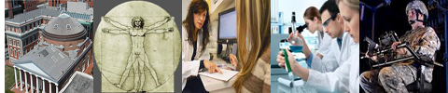
Introduction to the
Human Research Protections Office (HRPO)
Tara Catanzariti
IRB Administrator
Human Research Protections Office
Office of Academic Affairs – Research Compliance

Slide 2
Human Research Protections Program (HRPP)
Comprehensive system to ensure the protections of the rights and welfare of subjects in human research.
Based on all individuals, along with key individuals and committees, fulfilling their roles and responsibilities described in the HRPP Plan.

Slide 3
Human Research Protections Program
Components include:
  Institutional Official
  Institutional Review Board (IRB)
  Human Research Protections Office (HRPO)
  University Counsel
  Conflict of Interest Officer/Advisory Committee
  Investigational Drug Services
  Institutional Biosafety/Radiation Safety Committees
  Investigators/Research Team
HRPP Plan can be found on the Human Research Protections Office website.

Slide 4
Institutional Review Board
All Human Research must undergo review by an organizationally designated IRB.
Authority:
  Approve, require modifications to secure approval and disapprove human research
  Suspend or terminate approval of human research
  Observe the consent process and conduct of human research

Slide 5
Human Research Protections Office
Coordinating office for the HRPP
Provides support for the IRB
  Oversight of >2,000 research protocols
  New, Continuing Review, Modification
  Reportable New Information
  Meeting activities

Slide 6
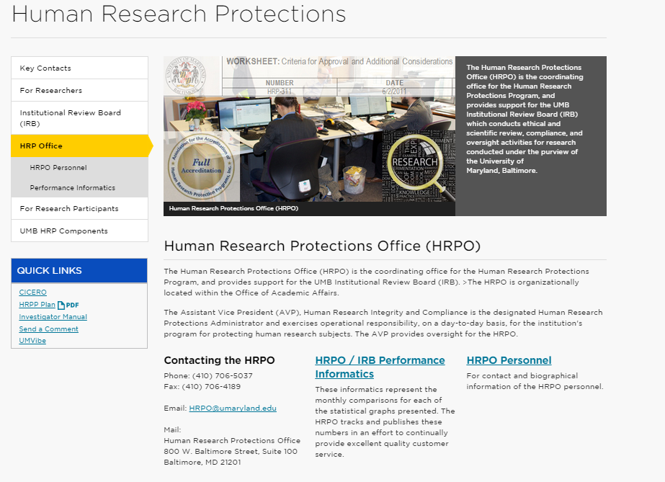
Human Research Protections Office
http://www.umaryland.edu/hrp

Slide 7
Getting Started
HRPO Website: www.umaryland.edu/hrp
Investigator Manual
HRPP Plan
RNI Bulletin
Instructional Videos
  CICERO Instructional Videos
  IRB Process Videos
  HRP Lecture Videos

Slide 8
Getting Started
Required Trainings:
  Collaborative Institutional Training Initiative (CITI)
    www.citiprogram.org
    Course in the Protection of Human Subjects
    Good Clinical Practices (NIH)
    Affiliate with University of Maryland, Baltimore or Baltimore, MD-512 (VA)
    Note: CICERO account and CITI account are not linked!
  HIPAA 125: Privacy and Security Review
  HIPAA 201: Human Research

Slide 9
CICERO
Web-based electronic system
Used to create, submit, route, review, document, track and communicate
Cooperative effort – supports multiple committees responsible for supporting research at the institution.

Slide 10
Communication via CICERO
Internal Comments
Public Comments
Contact HRPO
Contact Study Team
Determination Letters

Slide 11
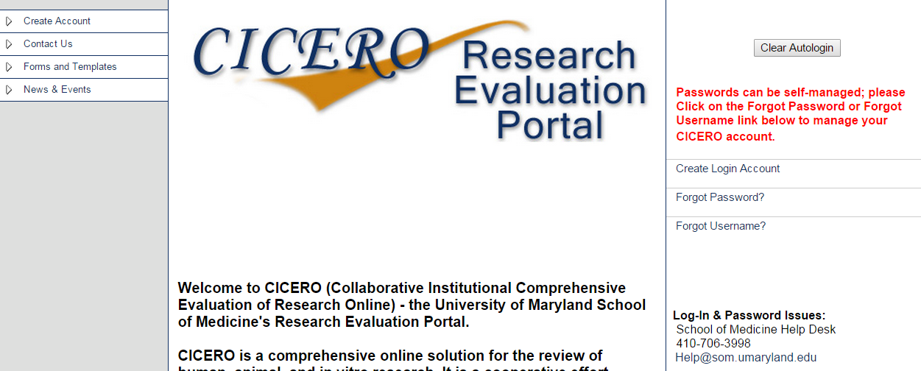
Requesting a CICERO account
cicero.umaryland.edu

Slide 12
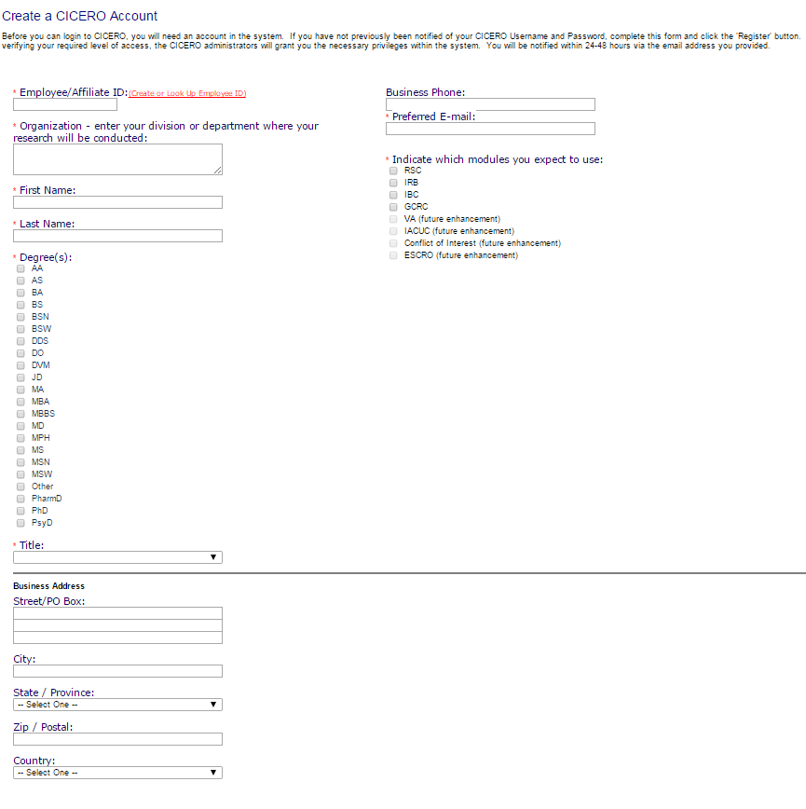
Requesting a CICERO account
Accounts may take up to 48 hours to be created.

Slide 13
The Principal Investigator
The Principal Investigator (PI) bears the ultimate responsibility for assuring that the conduct of the study complies with all UMB HRPP policies and procedures for the protection of human participants.
A PI must be a full time (>51% effort) Professor, Associate Professor or Assistant Professor at UMB.
PI Privileges must be added to a CICERO account.
Students and fellows are not permitted to be PIs.

Slide 14
CICERO Inbox
Displays all submissions for which you are the PI or a member of the study team
Roles & Submissions
  HRPO (IRB) – Researcher
  GCRC – Researcher
  IBC (Biosafety) – Researcher
  RSC (Radiation) – Researcher

Slide 15
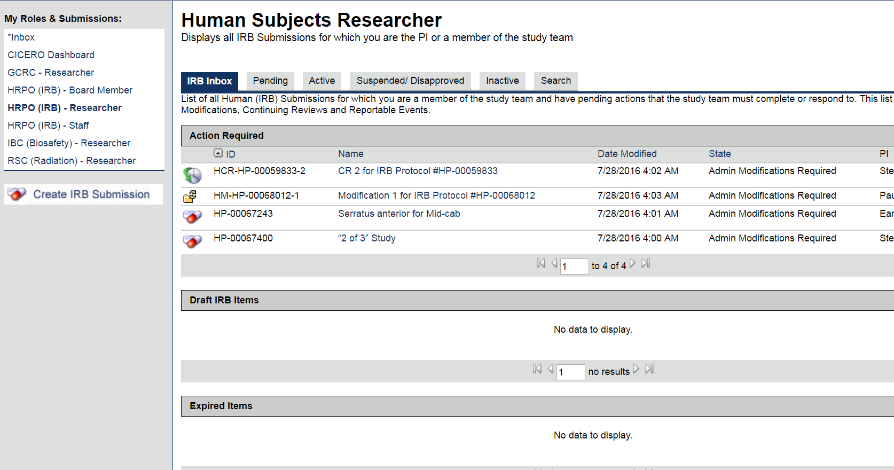
CICERO Inbox

Slide 16
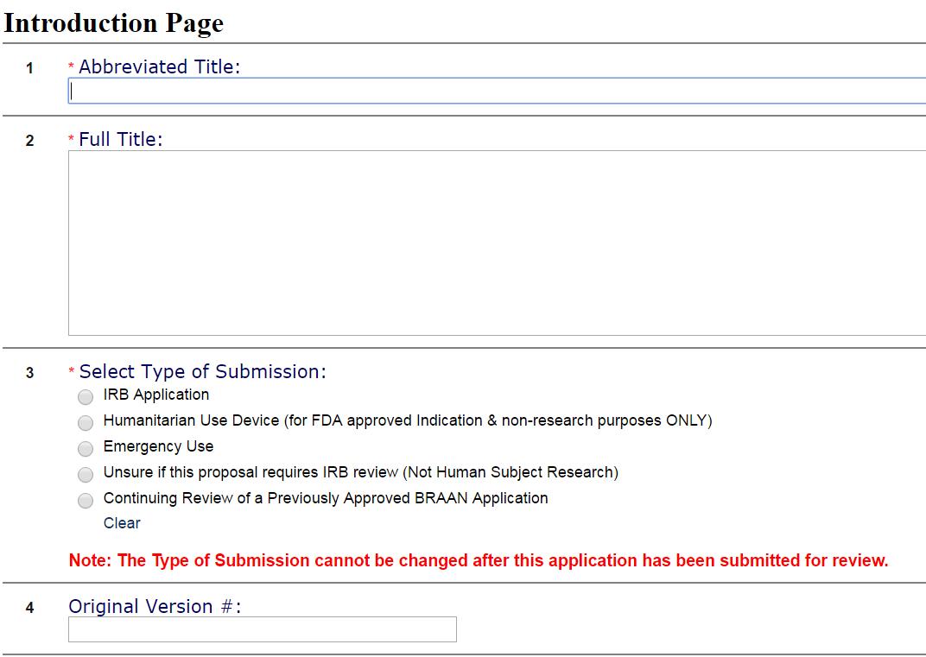
Creating a New Application
Notes:
Discuss question 3

Slide 17
Creating a New Application
Fill out the CICERO application completely and accurately
  Smart Form
  Any questions with a RED asterisk “*” require a response
  Help Text can be found throughout where the icon is visible

Slide 18
Submitting a New Application
Only the PI can submit a new application
Researchers are responsible to not conduct human research without prior IRB review and approval (or a determination that the research is exempt or not human subjects research)
Department Scientific and Feasibility Review
Specialty Review (Pediatrics, Cancer Center)

Slide 19
HRPO/IRB Review
Pre-review
Research?
Human Subjects Research?
Engaged?
Level of Review
  Exempt
  Expedited Procedure
  Convened IRB
Post Review
  Expedited vs. Convened IRB
  Consent stamping

Slide 20
Ask questions!
HRPO Operations Team
HRPP Directors
IRB Executive Committee
IT Support
Contact information is available at http://www.umaryland.edu/hrp/hrp-office/hrpo-personnel/ or http://www.umaryland.edu/hrp/institutional-review-board-irb/executive-committee/

Slide 21
Training and Education
Clinical Research Training and Mentoring Program (CRTMP)
  Assists with designing, submitting or revising protocols
  Meets personally with investigators
HRPP Education and Training

Slide 22
Questions?
Human Research Protections Office
Office of Academic Affairs, Research Compliance
620 W. Lexington Street, 2nd Floor
410-706-5037
hrpo@umaryland.edu
www.umaryland.edu/hrp

Slide 23
Contact Information
Tara Catanzariti
IRB Administrator
410-706-4514
tcatanzariti@umaryland.edu

